Slide 1
Jumping for JavaScript
Lesson 3.2
Notes:
630

Slide 2

Homework #2
Use Bootstrap CSS to re-create the portfolio you built in HW1
Minimize writing CSS (use Bootstrap classes)
Deploy on GitHub Pages
Include a well-written README
Due this Thursday at 11:59PM
Notes:
632-33
We will push the answers at the end of the unit
If you want to check your answers before-hand let us know and we’ll send them to you

Slide 3
Today’s Class
Jumping for JavaScript

Slide 4
Objectives
In today’s class, we’ll cover:
Array Assignments
The Concept of for Loops
The Art of Pseudocoding
Building Rock-Paper-Scissors
Jumping for JavaScript

Slide 5
Basics Recap
Jumping for JavaScript
Notes:
632-42

Slide 6

What is JavaScript?
(And what is it used for?)
Jumping for JavaScript
Notes:
632-42

Slide 7


JavaScript Definitions
JavaScript is the third of the three fundamental programming languages of the modern web (along with HTML and CSS).
JavaScript allows developers to create dynamic web applications capable of taking in user inputs, changing what’s displayed to users, animating elements, and much more.
Jumping for JavaScript
Notes:
632-42

Slide 8
What is a Variable?
(And how do we declare one?)
Jumping for JavaScript
Notes:
632-42

Slide 9
Variable Basics
Variables are the nouns of programming.
They are “things” (numbers, strings, booleans, etc.).
A variable is composed of a variable name and a value.
var name = ‘Fluffy’; var napCount = 7; var isSleeping = true;
Jumping for JavaScript
Notes:
632-42

Slide 10
What is meant by console.log?
(And how does it differ from an alert, prompt, or confirm?)
Jumping for JavaScript
Notes:
632-42

Slide 11
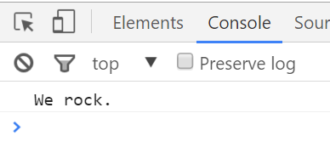
Basic Variables
console.log displays discreetly to the debugger.
console.log(‘We rock.’);
Jumping for JavaScript
Notes:
632-42

Slide 12
Alerts, Prompts, Confirms
Alerts, prompts, and confirms create a popup in the browser when run.
These are also useful for development and debugging.
// Alert alert(‘We definitely rock!’); // Confirm var doYouRock = confirm(‘The question is, do “you” rock?’); // Prompt var howMuchRock = prompt(‘How much do you rock?’);
This page says:
We definitely rock!
OK
This page says:
The question is, do “you” rock?
Prevent this page from creating additional dialogs.
OK
Cancel
This page says:
How much do you rock?
Prevent this page from creating additional dialogs.
OK
Cancel
Notes:
632-42

Slide 13
What is an array?
Jumping for JavaScript
Notes:
632-42

Slide 14
Basic Arrays
Arrays are collections of other variables.
These collections can be made up of strings, numbers, booleans, other arrays or objects.
Each element of the array is marked by an index. Indexes always start with 0.
var nickCharacters = [‘Tommy’, ‘Doug’, ‘Oblina’]; var diceNumbers = [1, 2, 3, 4, 5, 6,]; var mixedArray = [‘Zoo’, 12, ‘Carrot’, 3];
Notes:
632-42

Slide 15
How do we check conditions?
Jumping for JavaScript
Notes:
632-42

Slide 16
If/Else Statements Are Critical
Each statement is composed of an if, else-if, or else (keyword), a condition, and the resulting code in curly brackets { }.
// If the user likes anime (doesLikeAnime === true), we run the following block of code. if (doesLikeAnime) { alert(‘You like anime!’); } // If the user likes live action (doesLikeLiveAction === true), we run the following block of code. else if (doesLikeLiveAction) { alert(‘You like live action!’); } // If neither of the previous condition were true, we run the following block of code. else { alert("You don’t like visual media."); }
Notes:
632-42

Slide 17
Activity: Basic JavaScript Dissection
Notes:
642-45 (3 minutes)

Slide 18
Activity: Basic JavaScript Dissection
Re-examine 14-JSDissect
See if you can better understand how it works—at this point in today’s class.
Prepare to share once the time is up.
Jumping for JavaScript
Notes:
642-45 (3 minutes)

Slide 19
Activity: Array Logging
Notes:
642-47 (5 minutes)

Slide 20

Activity: Array Logging (15-CoolPeopleArray)
Follow the instructions provided in the file to console.log each of the names in the coolPeople variable.
Hint: You should be repeating the same line 6 times.
Jumping for JavaScript
Notes:
Two refresher activities for arrays
642-47 (5 minutes)
647-52 (5 min)

Slide 21
Activity: Array Setting
Notes:
5 minutes

Slide 22
Activity: Array Setting (16-ArraySetting)
Follow the instructions in 16-ArraySetting to convert each item in the array to lowercase.
Make sure to only add in lines of code where instructed.
Hint: You will need to use the method .toLowerCase(). Research if you don’t remember how to use it.
Jumping for JavaScript
Notes:
652-57 (6 min) (high priority)
Review: 657-701 (review)
Make drinks upper case
All caps
Just first letter
// We can either overwrite each element of the array to make it lowercase, or we can use the toLowerCase() method.
drinks[0] = 'coke';
drinks[1] = 'pepsi';
drinks[2] = 'water';
drinks[3] = drinks[3].toLowerCase();

Slide 23
Back to The Zoo Pen
Array Name: zooAnimals
Coded in JavaScript using an Array
Coded in JavaScript using an Array
Zebra | Rhino | Giraffe | Owl
Index 0 | Index 1 | Index 2 | Index 3
// Our array of zoo animals. var zooAnimals = [‘Zebra’, ‘Rhino’, ‘Giraffe’, ‘Owl’];
Notes:
700-05

Slide 24
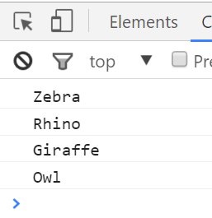
Back to The Zoo Pen
Array Name: zooAnimals
Coded in JavaScript using an Array
Zebra | Rhino | Giraffe | Owl
Index 0 | Index 1 | Index 2 | Index 3
// Array of zoo animals. var zooAnimals = [‘Zebra’, ‘Rhino’, ‘Giraffe’, ‘Owl’]; console.log(zooAnimals[0]); console.log(zooAnimals[1]); console.log(zooAnimals[2]); console.log(zooAnimals[3]);
Notes:
700-05
Next slide: what’s wrong here?

Slide 25
What’s wrong here?
// Array of zoo animals. var zooAnimals = ["Zebra", "Rhino", "Giraffe", "Owl"]; console.log(zooAnimals[0]; console.log(zooAnimals[1]; console.log(zooAnimals[2]; console.log(zooAnimals[3];
Jumping for JavaScript
Notes:
700-05

Slide 26
Don’t Repeat Yourself (DRY)
Repeated Code! Let’s be more efficient.
// Array of zoo animals. var zooAnimals = [‘Zebra’, ‘Rhino’, ‘Giraffe’, ‘Owl’]; console.log(zooAnimals[0]; console.log(zooAnimals[1]; console.log(zooAnimals[2]; console.log(zooAnimals[3];
Jumping for JavaScript
Notes:
700-05

Slide 27
Activity: For Loop Dissection
Notes:
5 minutes

Slide 28
Activity: For Loop Dissection (17-MyFirstLoop)
With a partner, spend a few moments trying to analyze and debug the code
Try to explain to one another what is happening in each line of code.
Feel free to do research if you are stumped. As a hint, look into the phrase “for loop”.
Be prepared to share when time is up.
Jumping for JavaScript
Notes:
Suggested Time: 5 minutes
When reviewing just say it’s a for loop which allows repeating code – next slides describe it in more detail

Slide 29
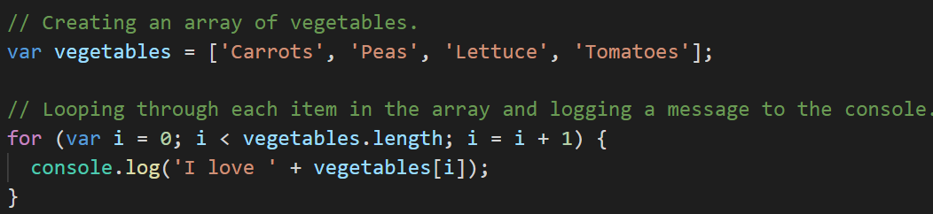
Enter the For Loop
For loops are critical in programming. We use loops to run repeated blocks of code over a set period.
Each for loop is composed of a:
Variable declaration or counter
Loop condition
Update (usually addition)
Jumping for JavaScript

Slide 30
Enter the For Loop
Variable declaration
Condition
Update
Jumping for JavaScript

Slide 31
Enter the For Loop
Code between the { } gets repeated as long as the condition is true
(in this case, as long as i < 4).
Jumping for JavaScript

Slide 32
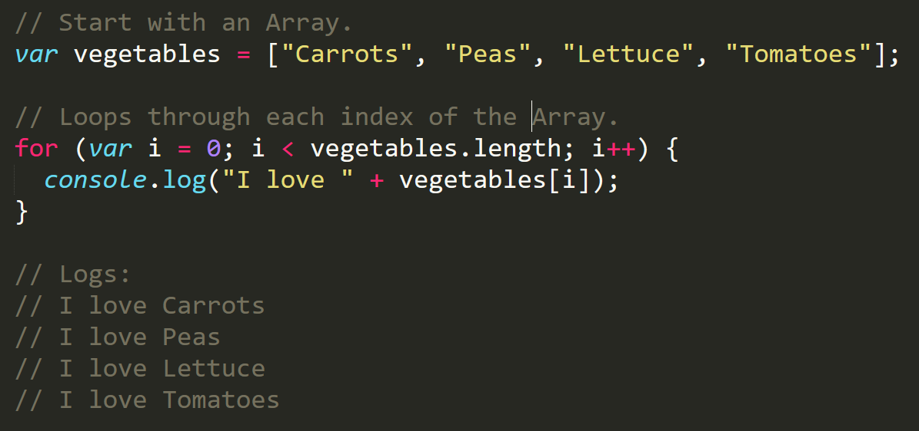
Enter the For-Loop
Running the code “loops” through and prints each element in the array.
Jumping for JavaScript

Slide 33
Run That Loop
When i = 0 … console.log(‘I love Carrots’)
Carrots | Peas | Lettuce | Tomatoes
Index 0 | Index 1 | Index 2 | Index 3
Jumping for JavaScript

Slide 34
Run That Loop
When i = 1 … console.log(‘I love Peas’)
Carrots | Peas | Lettuce | Tomatoes
Index 0 | Index 1 | Index 2 | Index 3
Jumping for JavaScript

Slide 35
Run That Loop
When i = 2 … console.log(‘I love Lettuce’)
Carrots | Peas | Lettuce | Tomatoes
Index 0 | Index 1 | Index 2 | Index 3
Jumping for JavaScript

Slide 36
Run That Loop
When i = 3 … console.log(‘I love Tomatoes’)
Carrots | Peas | Lettuce | Tomatoes
Index 0 | Index 1 | Index 2 | Index 3
Jumping for JavaScript
Notes:
Demo this in Chrome
Set a breakpoint on vegetables and walk through in Chrome Debugger

Slide 37
Shorthand (Syntactic Sugar) for incrementing and decrementing
We increment and decrement values by 1 all the time
We’re lazy so we made shorthand operators for this
Post-increment operator: i++ (translates to i = i + 1)
Post-decrement operator: i-- (translates to i = i -1)
Most operators also have combined assignment
i += 1; i -= 1; i *= 3; i /= 6;

Slide 38
Activity: For Loop Zoo
Notes:
15 minutes

Slide 39
Activity: For Loop Zoo (18-ZooLoop)
01
Spend a few moments refactoring the code below to use a for loop
02
If you need help, use the code from the previous example as a guide
03
Then try to explain to the person next to you how your code works
// Array of zoo animals. var zooAnimals = [‘Zebra’, ‘Rhino’, ‘Giraffe’, ‘Owl’]; console.log(zooAnimals[0]; console.log(zooAnimals[1]; console.log(zooAnimals[2]; console.log(zooAnimals[3];
Jumping for JavaScript
Notes:
Suggested Time: 15 minutes

Slide 40
Activity: Another Loop
Notes:
Break before activity
15 minutes

Slide 41

Activity: Another Loop (19-AnotherLoop)
Starting from scratch, create a for loop that prints the following lines:
I am 0
I am 1
I am 2
I am 3
I am 4
This time, don’t use an array!
Jumping for JavaScript
Notes:
Suggested Time: 15 minutes
optional

Slide 42
Group Activity (2 people): Loop with Conditions
Notes:
10 minutes

Slide 43
Boolean operators
You can combine booleans using one of two operators
OR (||)
“OR” as in “either”
x === 0 || x === 1
AND (&&)
“AND” as in “both”
x. indexOf(‘p’) !== -1 && x.indexOf(‘izza’) !== -1

Slide 44
Group Activity: Loop with Conditions (20-HardLoop)
Starting from scratch, write code that loops through the following array:
Use console.log to display the name of each animal on the farm.
Using the .charAt() method (research it), check if the first letter in the animal’s name begins with a “c” or “o”. If it does, create an alert saying: “Starts with c or an o!”
Jumping for JavaScript
Notes:
Break before activity - 15 minutes
Suggested Time: 10 minutes
// This is our starting myFarm array
var myFarm = ['chickens', 'pigs', 'cows', 'horses', 'ostriches'];
// Creating a variable to hold our array length
var arrayLength = myFarm.length;
// Looping through our myFarm array
for (var i = 0; i < arrayLength; i++) {
var animal = myFarm[i];
// Console out the farm animal in the current index
console.log(animal);
// If the first character in the current animal is 'c' or 'o', alert the following message
if (animal.charAt(0) === 'c' || animal.charAt(0) === 'o') {
alert(animal + ' starts with a c or an o!');
}
}
// BONUS!
// Looping through our myFarm array
for (var i = 1; i < arrayLength; i++) {
var currAnimal = myFarm[i];
var prevAnimal = myFarm[i - 1];
// Console out the farm currAnimal in the current index
console.log(currAnimal);
if (currAnimal.length === prevAnimal.length) {
console.log('I just saw an animal like that!');
}
}

Slide 45
Group Activity (2 people): Pseudocode Rock-Paper-Scissors (RPS)
Notes:
3 minutes

Slide 46

Rock-Paper-Scissors with the Person Next to You!
Play five rounds.
Jumping for JavaScript

Slide 47
Random Numbers (21-RandomNumbers)
Use Math.random() to generate 10 random numbers
They should all be whole numbers
Each number should be between 1 and 10
Jumping for JavaScript
Notes:
805-812
Suggested Time: 7 minutes
You will need to google to figure this out
// Loop 10 times
for (var i = 0; i < 10; i++) {
// Generate a random number between 1 and 10
// Math.floor will round down, meaning we would get a number between 0 and 9, so we'll always add 1 to bump it up.
var num = Math.floor(Math.random() * 10) + 1;
// Display in console
console.log(num);
}

Slide 48
Group Activity: Pseudocode RPS (22-PseudoCode)
With a partner, spend a few moments outlining all the steps and conditions that go into a single game of rock paper scissors.
Try to break it down into steps that you could “code out.”
Think of basic elements like loops, if-then statements, arrays, alerts, etc.
Hint: Starting by playing rock paper scissors should help
Jumping for JavaScript
Notes:
812-820
Suggested Time: 8 minutes

Slide 49

You just pseudocoded!
Jumping for JavaScript
Notes:
shutterstock_288649979

Slide 50
Let’s code it!
Jumping for JavaScript

Slide 51
Don’t worry. We’ll be here to help you along the way.
Jumping for JavaScript

Slide 52
Group Challenge (4 people): Coding Out RPS
Jumping for JavaScript
Notes:
60 minutes

Slide 53
Group Challenge: Programming RPS (23-RPS-Coded)
In groups of four, begin the process of coding out the rock-paper-scissors game.
Do as much as you can on your own, but don't be afraid to ask for help if you feel your team is struggling.
Notes:
820-920
Suggested Time: 60 minutes
Bonus – lookup switch statements
Demo the final solution first
Review the solution for 10 minutes
920-30

Slide 54
Let’s Fill in the Missing Code (Together)
Jumping for JavaScript
Notes:
930-930
5 minutes if there’s time

Slide 55
Questions?
Jumping for JavaScript
Notes:
927-930

